Slide 1
Information Theory
(10.6 ~ 10.10, 10.13 ~ 10.15)
Neural Networks
  Huafu Chen
  SLST, UESTC

Slide 2
Index
Application of Information Theory to self-organizing systems
  Case 1 : Feature Extraction
  Case 2 : Spatially Coherent Features
  Case 3 : Spatially Incoherent Features
  Case 4 : Blind Source Separation
Summary

Slide 3
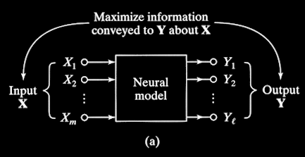
Case 1 : Feature Extraction
Objective Function : maximize I(Y; X)
Notes:
Maximum mutual information principle (Linsker 1988), it states that the synaptic connections of a multi-layered neural network develop in such a way as to maximize the amount of information that is preserved when signals are transformed at each processing stage of the network, subject to certain constraints.
Linsker 在1988年左右提出本原理时，发表的文章的档次并不高，最好的杂志是Neural Computation 和一些会议文集等。
但在1986年时，在PNAS上发表了3篇系列文章。

Slide 4
Case 1 : Formal Statement
Infomax ( i.e. Maximum mutual information ) Principle :
-- due to Linsker (1987,…)
The transformation of ...
a random vector X observed in the input layer of a neural system
to a random vector Y produced in the output layer of the system
should be so chosen that ...
the activities of the neurons in the output layer
jointly maximize information
about the activities in the input layer.
The objective function to be maximized is …
the mutual information I(Y;X) between the vectors of X and Y

Slide 5
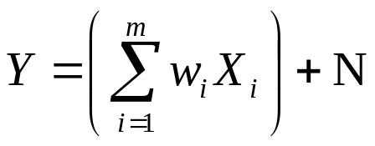
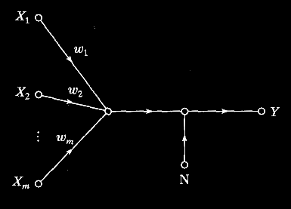

Case 1 : Examples 10.4
Single Neuron corrupted by Processing Noise /p.499
(10.46)
About h(Y)--Assume output Y is a Gaussian random variable with variance σ²_{Y} :
if all X1,.., Xm and N are gaussian distributed;
or if X1… Xm are identically and independently distributed (iid), and m is large ( central limit theorem).
N : Gaussian random variable
with zero mean & variance σ²_{N}
Notes:
I 最大, 由于h(Y)(输出已知), I 最大 就是意味着 h(Y|x)最小, 就是 知道x,y就尽可能的被定了

Slide 6
Case 1 : Examples 10.4
(10.46)
About h(Y|X)– by (10.46):
given the input vector X, the pdf Y is the same as “the pdf of a constant” plus a Gaussian-distributed random variable.
Accordingly, The conditional entropy h(Y|X) is the information that the output neuron conveys about the processing noise N, rather than about the the signal vector X.
Thus h(Y|X)=h(N), I(Y;X)=h(Y)-h(N).
Asssume the pdf of N is a Gaussian distribution, then we have :

Slide 7
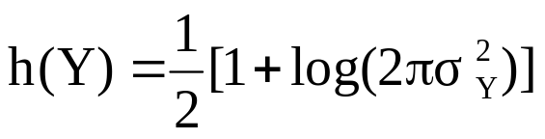
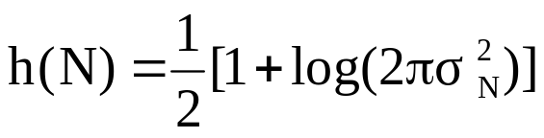
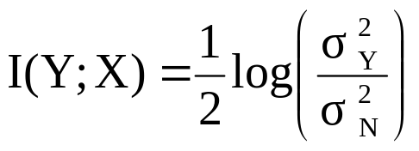
Case 1 : Examples 10.4
the differential entroy of a gaussian variable is (10.22)/page 491
The variances ratio may be viewed as signal-to-noise ratio.
Assume the noise variance is fixed, the MI is maximized by maximizing the variance of the neuron output Y.
Under some conditions, maximizing the output variance of a neuron maximizes the MI between the output signal of that neuron and its inputs ( Linsker, 1988)

Slide 8
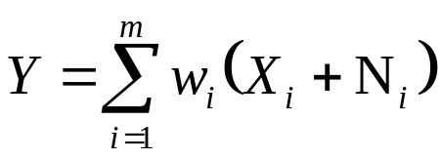
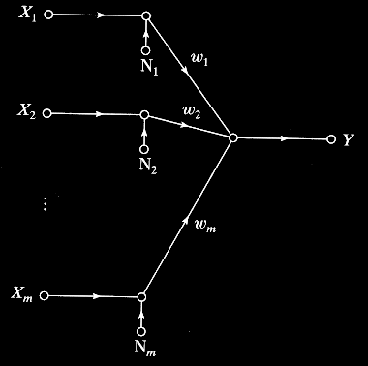

Case 1 : Examples 10.5
Single Neuron corrupted by Additive Input Noise
Y : Gaussian random variable
with variance σ²_{Y}
N_{i} : Gaussian random variable
with zero mean & variance σ²_{N}

Slide 9
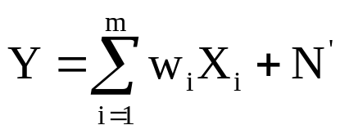
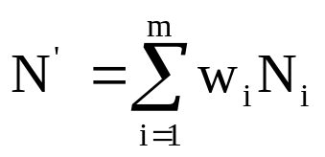
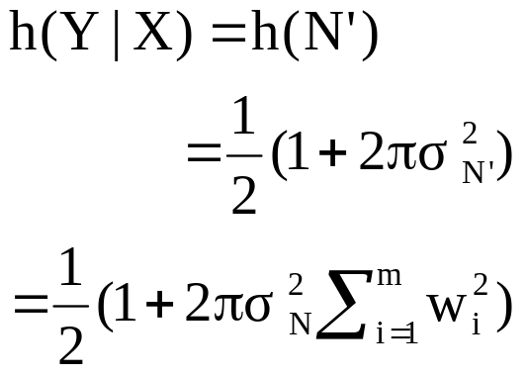
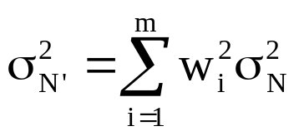
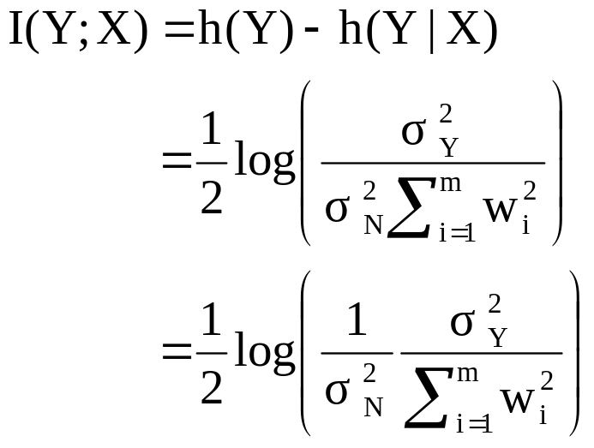
Case 1 : Examples 10.5
Linsker (1988)
Under the constraints that the noise variance is maintained constant, the MI is now maximized by maximizing the variance ratio, where the variance of the neuron output Y is a function of the weight w.

Slide 10
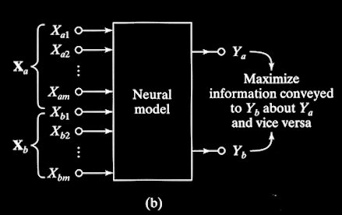

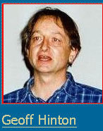
Case 2 : Spatially Coherent Features
Suzanna Becker
Find similarity between 2 input regions
Objective Function : maximize I(Y_{a} ; Y_{b})
Notes:
Becker S and GE Hinton,1992. Nature, 355:161-163

Slide 11
Case 2 : Formal Statement
First Variant of Infomax Principle :
The transformation of ...
a pair of vectors X_{a} and X_{b} (representing adjacent, nonoverlapping
regions of an image by a neural system )
should be so chosen that ...
the scalar output Y_{a} of the system due to the input X_{a}
maximizes information
about the second scalar output Y_{b} due to X_{b}.
The objective function to be maximized is …
the mutual information I(Y_{a};Y_{b}) between the outputs Y_{a} and Y_{b}

Slide 12
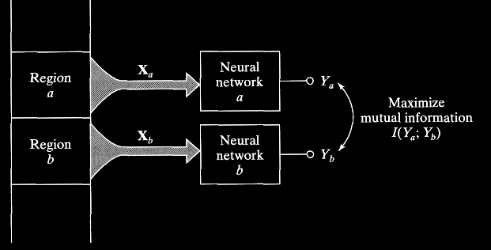

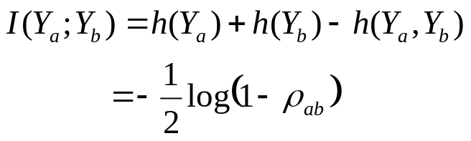
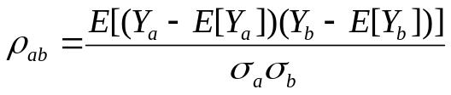
Case 2 : Example
X_{a} , X_{b} : input from adjacent,
non-overlapping region of image
Y_{a}, Y_{b} : corresponding output
S : a signal component
common to Y_{a} & Y_{b} (also Gaussian)
N_{a}, N_{b} : statistically independent,
zero-mean additive Gaussian noise
ρ_{ab} :correlation coefficient of Y_{a}& Y_{b}
The derivation: page 507
Notes:
S 共同的特征，

Slide 13
Case 2 : Example
The result:
Maximizing the mutual information I is equivalent to maximizing the correlation coefficient.
Maximizing the MI may be viewed as the nonlinear generalization of canonical correlation in statistics( Becker and Hinton, Nature,1992).
Given two inputs vectors ( not necessary of the same dimensionality), and two corresponding weight vectors, the objective of canonical correlation analysis is to find linear combinationYa=W^{T}aXa and Yb=W^{T}bXb, that have maximum correlation between them( Anderson, 1984). Maximizing MI is a nonlinear generalization of canonical correlation by virtue of the nonlinearity bulit into the design of the neural network (shown above).
Becker and Hinton(1992) demonstrated this method can be used to extract stereo/体视 problem， that could not be solved by a one-layer or linear neural network， disparity(depth)/体视不均衡性（深度） from random dot stereograms/随机体视点图. It is a difficult feature extraction.
Notes:
可以从一个随机体视点图中提取体视不均衡性（深度）。

Slide 14
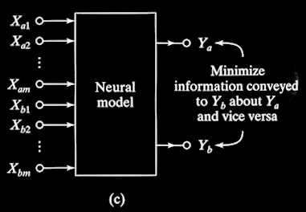
Case 3 : Spatially Incoherent Features
Find difference between 2 input regions
Objective Function : minimize I(Y_{a}; Y_{b})

Slide 15
Case 3 : Formal Statement
Second Variant of Infomax principle :
The transformation of…
a pair of input vectors X_{a} and X_{b}, representing data derived from
corresponding regions in a pair of separate images by a neural system
should be so chosen that ...
the scalar output Y_{a} of the system due to the input X_{a}
minimizes information
about the second scalar output Y_{b} due to X_{b}.
The objective function to be minimized is …
the mutual information I(Y_{a};Y_{b}) between the outputs Y_{a} and Y_{b}
Notes:
目的是增强从两个不同图象中，抽取相应区域的空间差异。

Slide 16
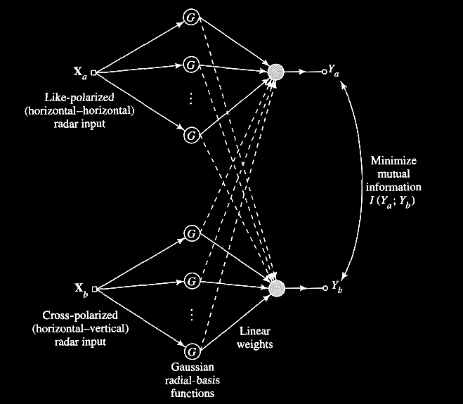


Case 3 : Example/page 510
Removing clutters/杂波/杂乱 in polarized radar image
利用一对偏振测量的非相干雷达输入消除杂波
The requirement is to suppress the radar clutter that is common to the horizontally polarized and vertically polarized radar images.
To satisfy this requirement, the MI I(Ya;Yb) is minimized, subject to a constraint imposed on the synaptic weights:
类偏振
交叉偏振
W : overall weight matrix of the network
Y_{a}, Y_{b} : output of network (gaussian)
Solve this constrained optimization problem using the method of Lagrange multipliers
Notes:
发表在Neural Network 1996
在一个偏振方向上发射，在两个方向上接收，

Slide 17
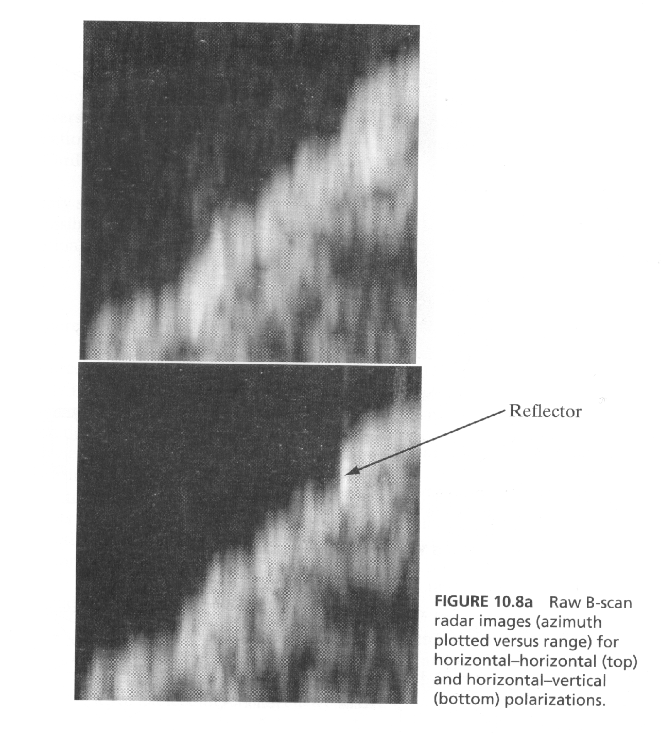
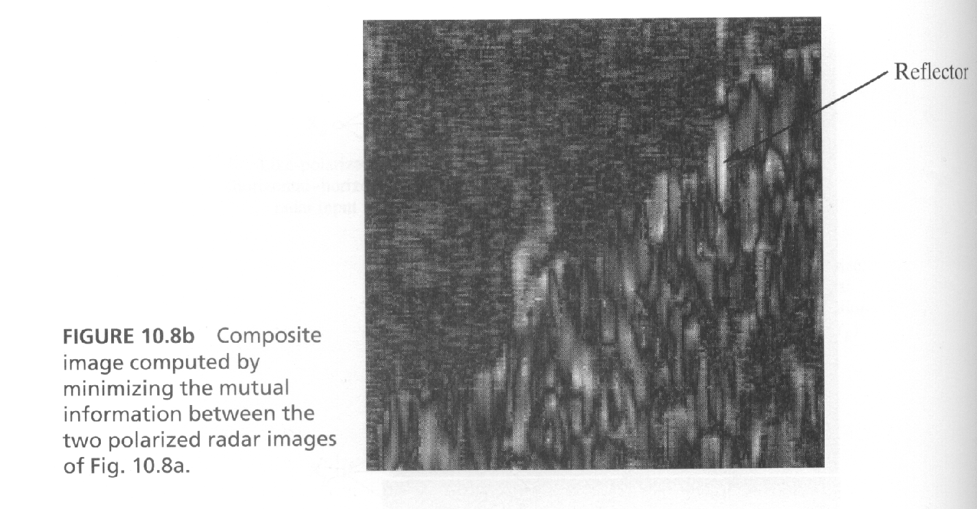
最小化左边两图 MI，计算得出的合成图象
未处理的B-扫描雷达图象
H-H图象（上）
H-V图象（下）

Slide 18
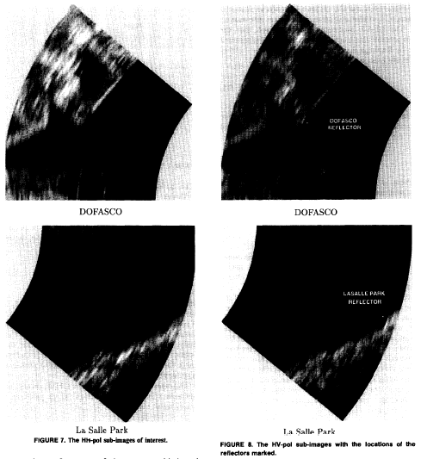
Left: HH sub-images; Right: HV sub-images

Slide 19
Left: HH sub-images; Right: HV sub-images

Slide 20
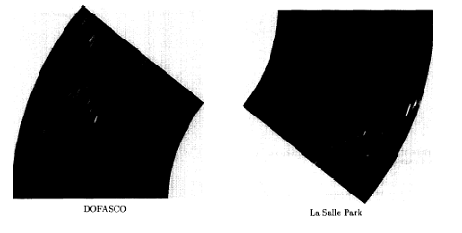
Composite images comupted by minimizing the MI between the two polarized radar images.

Slide 21
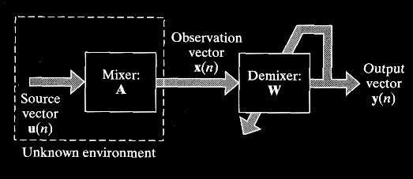
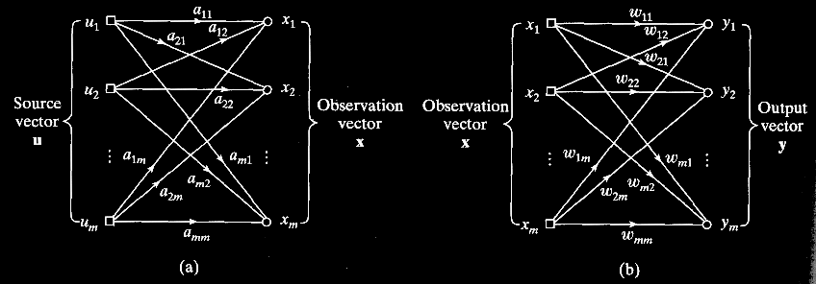
Case 4 : Blind Source Separation
X=AU
Y=WX
(=> Y=U iff W=A⁻¹⁾
Estimate unknown underlying source vector U by building inverse transformation W

Slide 22
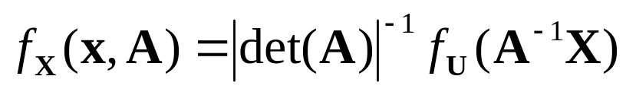
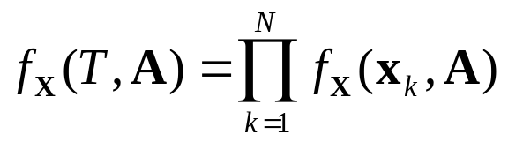
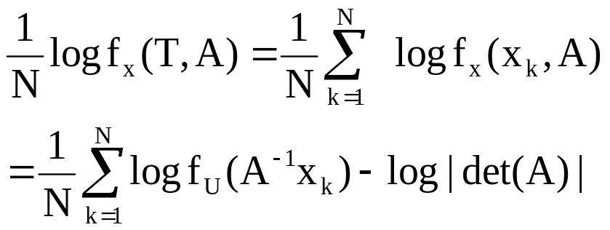
Case 4:Maximum Likelihood Estimation(MLE)
- A method for blind source separation in an unsupervised manner.
Let f_{U} denotes the PDF of the random source vector U. Then the PDF of observation vector X=AU at the output of the mixer is defined by (Papoulis, 1984)
(10.112)
Assume T denotes a set of N independent realizations of the random vector X, we may then write
(10.113)
Convert to Normalized log-likelihood function
(10.114)

Slide 23

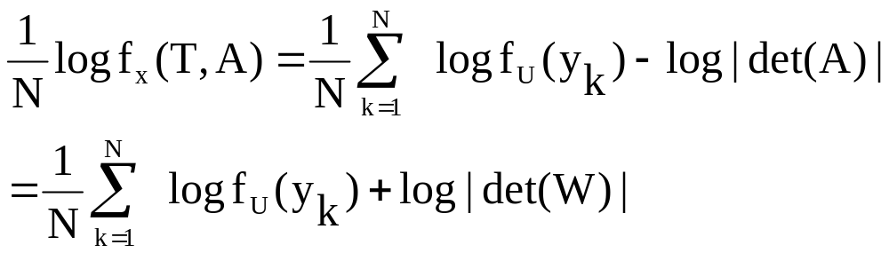
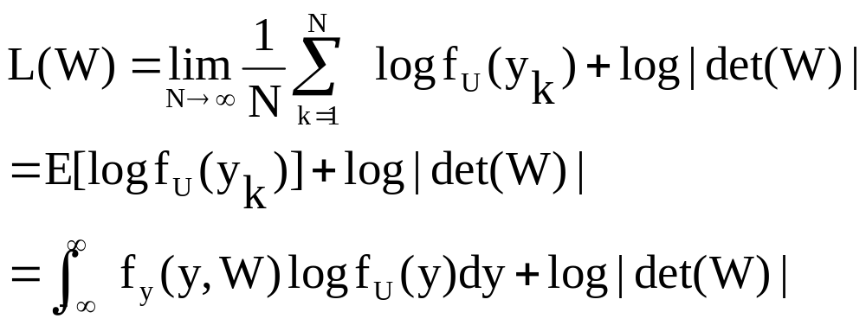
Case 4:Maximum Likelihood Estimation(MLE)
apply some substitution, then we get
(10.114)
From the law of large numbers, we have
(10.115)
Notes:
L(W)– likelihood,,
最大Likelihood 就是找出一个模型（参数），使得实际的观测是这个模型的最大概率情况。

Slide 24
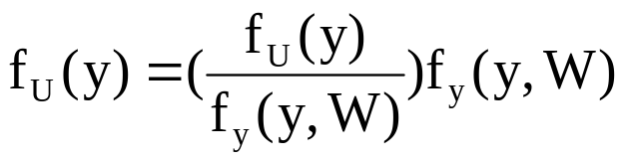
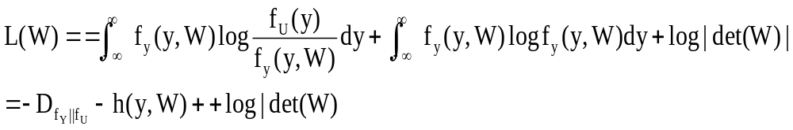
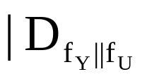
Case 4:Maximum Likelihood Estimation(MLE)
In summary:
f_{U} denotes the PDF of the random source vector U; X=AU; f_{U} (y)= f_{U} (A⁻¹ X)= f_{U} (u) ( ideally case)
2) f_{y} (y,W) denotes the PDF of Y parameterized by W. Y=WX. ( practically case)
is the K-L divergence between the f_{U} (y) and f_{y} (y,W)

Slide 25
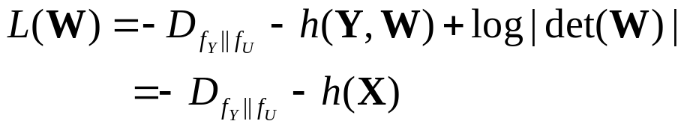
Case 4:Maximum Likelihood Estimation(MLE)
h(y,W) is the differential entropy of random vector y parameterized by W, and according to (10.76), h(y)=h(WX)=h(X)+log|det(W)|=h(y,W)
(10.117)
Only the first term depends on the weight vector W.
* Maximizing the log-likelihood function L(W) is equivalent to minimizing Kullback-Leibler divergence D_{fy||fu} ,
* that is, matching the probability distribution of the demixer output Y to that of the original source vector U
Summary: MLE results in a W, and Y=WX provides a unsupervised blind source separation. ( The closely related to ICA, page 527)

Slide 26
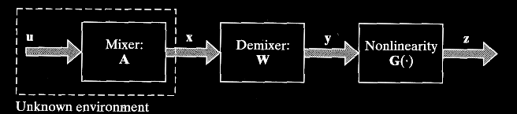
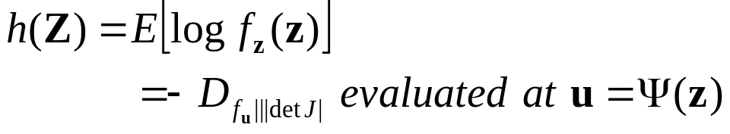
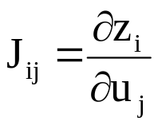
Case 4 : Maximum Entropy Method
-- another method for blind source separation in an unsupervised manner (Bell and Sejnowski, 1995)
Block diagram of MEM
G is monotonic and invertible.
Z=G(Y) =G(WAU)
U=A⁻¹ W⁻¹ G⁻¹ (Z) =Ψ(Z)
* J : Jacobian J(u) of Z
For a prescribed nonlinearity G(.), such as the logistic function, the MEM produces an estimate of the original source vector U by maximizing the entropy h(Z) with respect to W.

Slide 27
Case 4 : Maximum Entropy Method
-- another method for blind source separation in an unsupervised manner
Maximizing the entropy of the random vector Z at the output of the nonlinearity G is then equivalent to W=A⁻¹ , which yields perfect blind source separation.
if Z_{i} is uniformly distributed inside the interval [0,1] for all i, then Maximum Entropy & MLE is equivalent
In light of eq.(10.55), the maximum entropy method is closely related to the Infomax principle.

Slide 28
Summary
Application of Information Theory to self-organizing systems
  Case 1 : Feature Extraction
    Infomax principle
  Case 2 : Extraction of Spatially Coherent Features
    1st variant of Infomax
  Case 3 : Extraction of Spatially Incoherent Features
    2nd variant of Infomax
  Case 4 : Blind Source Separation
    ICA vs Maximum Entropy Method/ MLE

